Slide 1
24 WICOR
7
30
Write a Summary from last lesson
A class of students has measured their heights.
146, 148, 151, 153, 153, 154, 155, 156, 156, 156, 157, 157, 159, 162, 162, 162, 163, 164, 164, 165, 165, 168, 168, 173, 174, 177, 181.
Calculate the mean, mode, median and range?
How could we present this information diagrammatically?
With a partner, name five types of graphs you might see in advertising.

Slide 2
Mean = 161.0740741
Mode = 156
Median = 162
Range = 35
Pie Chart, Line graph, Dot Plot, Scatter Plot,

Slide 3
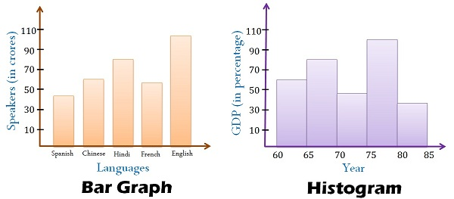
Today’s lesson is about histograms.
A histogram looks a lot like a column graph but there are a couple of key differences.
Gaps
No Gaps
Data is categorical and bars can be swapped around
Data is continuous numerical and columns cannot be swapped around

Slide 4
24
7
30
Histograms
Date
EQ – What steps do I follow to create a histogram?
What is a histogram?
A histograms shows the frequency of continuous numerical data.
Notes:
iler

Slide 5
24
7
30
Histograms
Date
EQ – What steps do I follow to create a histogram?
What is a histogram?
A histograms shows the frequency of continuous numerical data.
List the steps to create a histogram?
Look at the range of the data to help decide on a “class width”.
Lets look at the data we used for the warm up.
146, 148, 151, 153, 153, 154, 155, 156, 156, 156, 157, 159, 162, 162, 162, 163, 164, 164, 165, 165, 168, 168, 173, 174, 177, 181.
The range was found to be 35.
I want to create a histogram with between 5 and 20 “classes” (or columns). If you can choose a class width using a number that is easy to calculate with. A class width of 10 creates only 4 classes, while a class width of 5 (starting at 145) creates 8 classes. A class width of 2 is possible but will create 16 classes many of which will have only 1 or 2 results in them.
Notes:
iler

Slide 6
24
7
30
Histograms
Date
EQ – What steps do I follow to create a histogram?
What is a histogram?
A histograms shows the frequency for continuous numerical data.
List the steps to create a histogram?
Look at the range of the data to help decide on a “class width”.
Use the class width to create a frequency table.
We have decided to use class widths of 5. Lets create a frequency table from our data.
146, 148, 151, 153, 153, 154, 155, 156, 156, 156, 157, 157, 159, 162, 162, 162, 163, 164, 164, 165, 165, 168, 168, 173, 174, 177, 181.
145 – 149
150 – 154
155 – 159
160 – 164
165 – 169
170 – 174
175 – 179
180 – 184
|| = 2
|||| = 5
||||| = 6
||||| = 6
|||| = 4
|| = 2
| = 1
| = 1
Notes:
iler

Slide 7
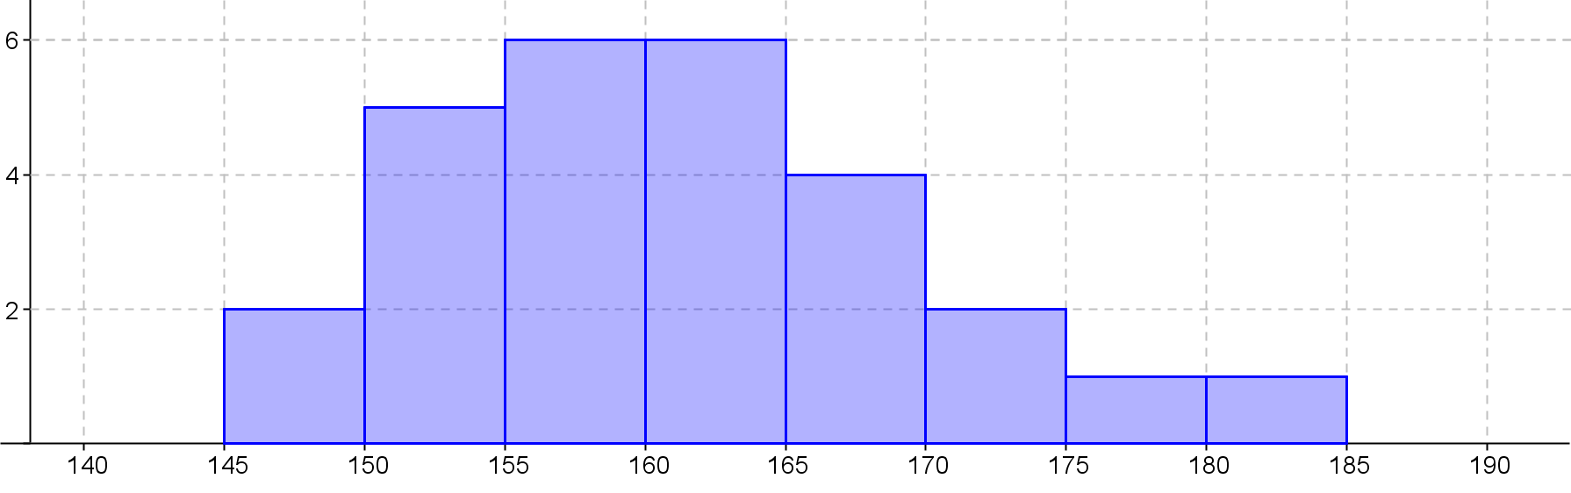
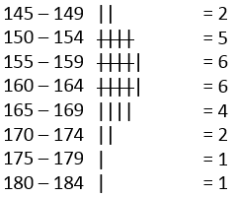
24
7
30
Histograms
Date
EQ – What steps do I follow to create a histogram?
What is a histogram?
A histograms shows the frequency for continuous numerical data.
List the steps to create a histogram?
Look at the range of the data to help decide on a “class width”.
Use the class width to create a frequency table.
Create a set of Axis that will accommodate all the data we wish to show.
Frequency
Our maximum frequency is 6 so our y axis must go to at least 6 and we use our class widths to determine the x axis
Height(cm)
Notes:
iler

Slide 8
24
7
30
Histograms
Date
EQ – What steps do I follow to create a histogram?
What is a histogram?
A histograms shows the frequency for continuous numerical data.
List the steps to create a histogram?
Look at the range of the data to help decide on a “class width”.
Use the class width to create a frequency table.
Create a set of Axis that will accommodate all the data we wish to show.
Use the frequency data from the frequency table to complete the graph and add a title.
Heights of students in 8-7
Title
Frequency
No Gaps between the columns
Labels
Height(cm)
Notes:
iler

Slide 9
24
7
30
Date
Histograms
EQ – What steps do I follow to create a histogram?
Heights of students in 8-7
Title
Frequency
No Gaps between the columns
Height(cm)
Labels
Scale
How the data looks in a histogram is important and can be described in main ways
Notes:
iler

Slide 10
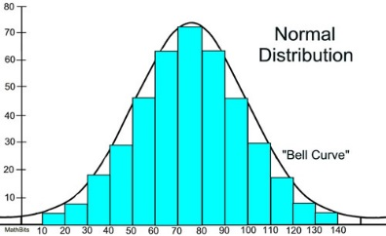
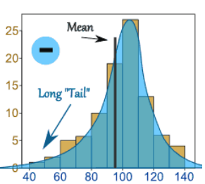
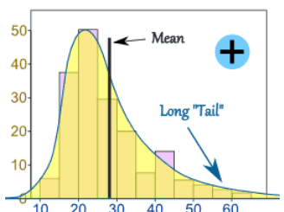
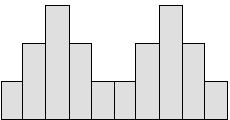
24
7
30
Date
Topic - Data
EQ – How do we describe data distribution.
Normal Distribution – Not skewed
A Normal Distribution is not skewed.
It is perfectly symmetrical and the Mean, mode and median are all exactly at the peak.
Negative Skew
The long "tail" is on the negative or left side
the peak. The mean is also on the left of the peak. The Median is closer to the peak and the mode is at the peak.
Positive Skew
The long tail is on the positive or right
side of the peak. The mean is also on the right of the peak value. The median will be close to the peak and the mode is at the peak
Biomodal
Bimodal means it has 2 modes.
On a graph it has 2 peaks which are its 2 modal values.
Notes:
Go through with class piece by piece

Slide 11
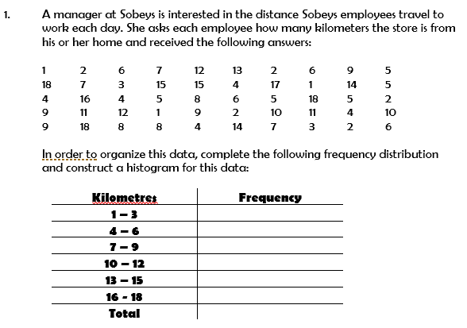
Let’s Try Together….
10
14
10
6
5
5
50

Slide 12

Let’s Try Together….
10
14
10
6
5
5
50

Slide 13
Glue todays worksheet in the LHS of your workbook and show it to your teacher before you leave.
Extra practice is on pages 124 and 125 of the Dr Dwyer yr 9 text

